Slide 1
Generalization
Understanding Machine Learning
October 2022
Felix Wick

Slide 2
Generalization
core of ML:
empirical risk minimization (training error) as proxy for minimizing unknown population risk (test error, aka generalization error or out-of-sample error)
generalization gap: difference between test and training error
interpolation: to unencountered samples from training environment
extrapolation: to testing conditions differing from training environment
curse of dimensionality: “learning in high dimensions always amounts to extrapolation”

Slide 3
Bias-Variance Tradeoff

Slide 4


Bias, Variance, Irreducible Error
think of fitting ML algorithms as repeatable processes with different (i.i.d.) data sets
irreducible error (aka Bayes error):
inherent randomness (target generated from random variable following probability distribution)
limiting accuracy of ideal model
different potential reasons for inherent randomness (noise): complexity, missing information, …
bias:
due to too simplistic model (same for all training data sets)
“underfitting”
variance:
due to sensitivity to specifics (noise) of different training data sets
“overfitting”

Slide 5
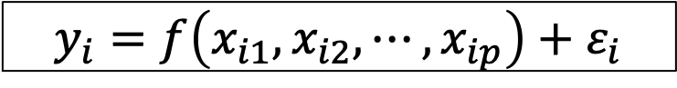
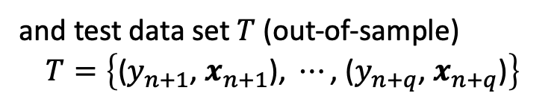
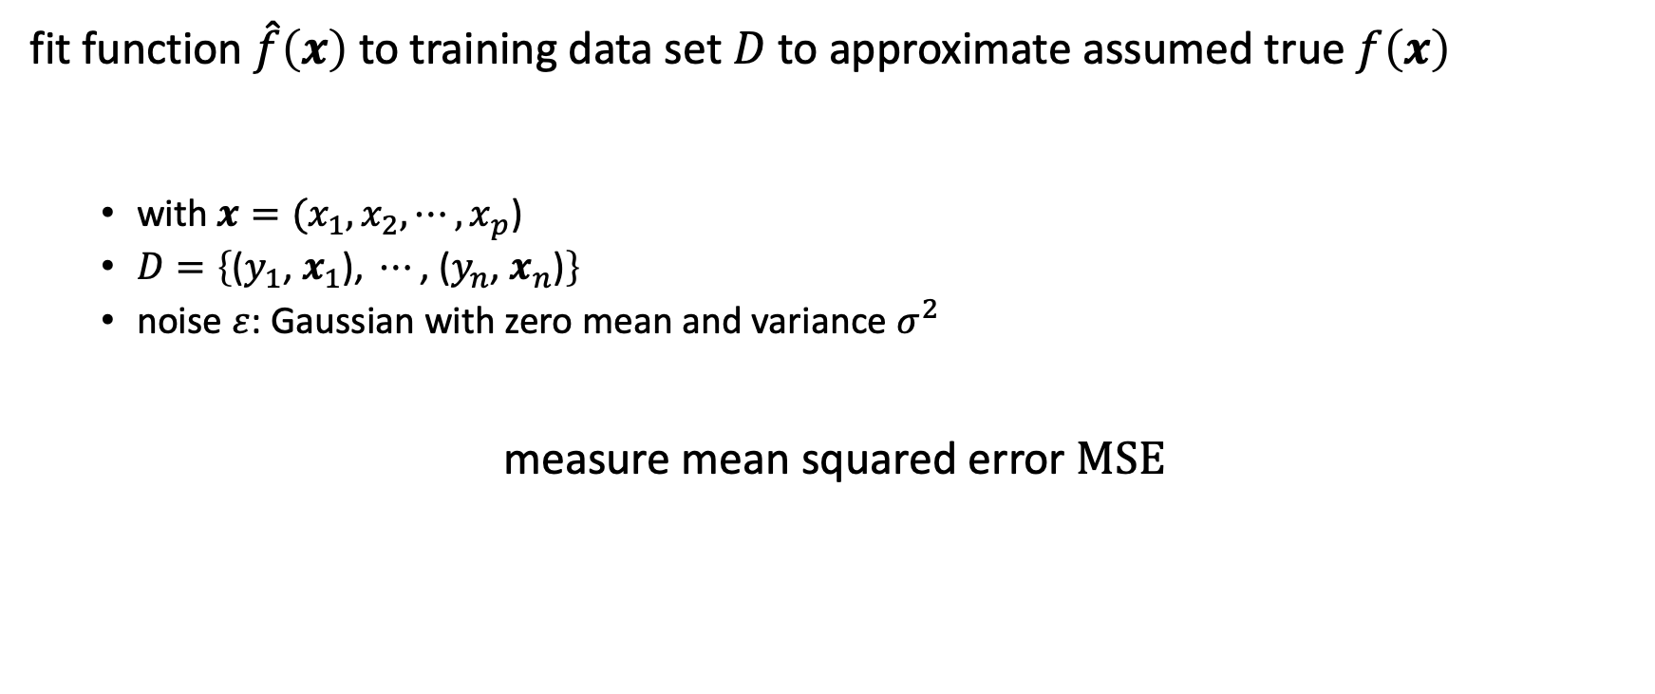
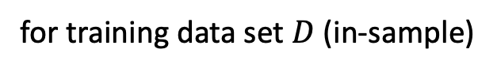
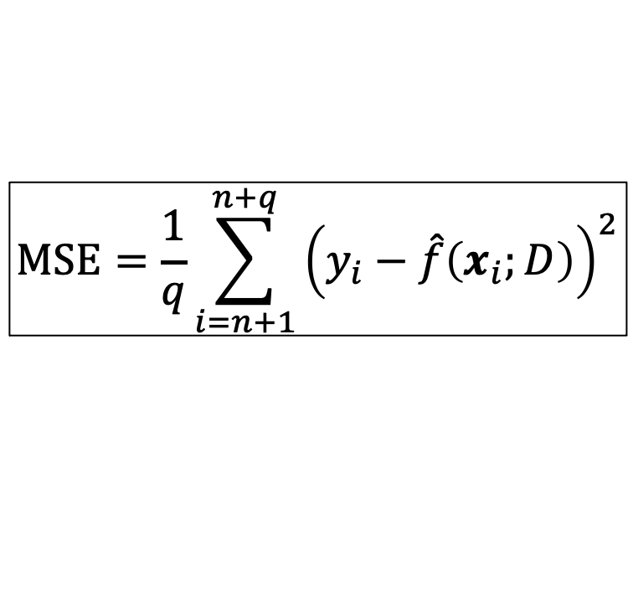
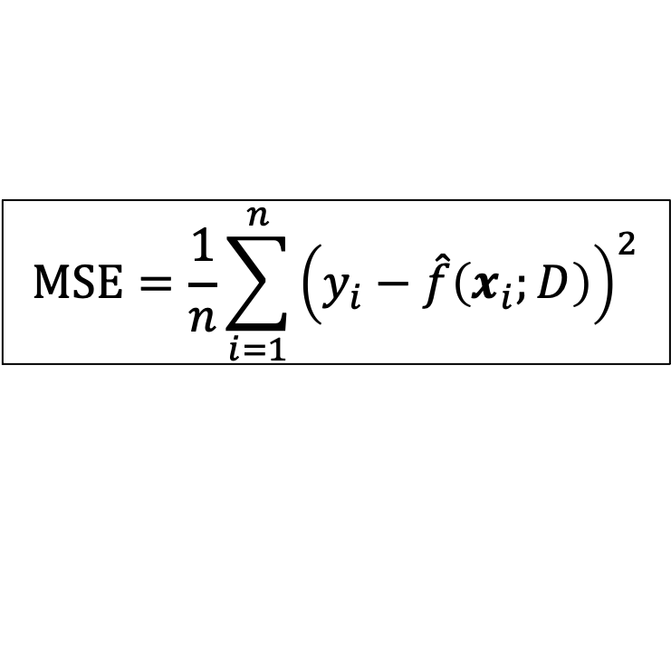
Mean Squared Error
fit function $\hat{f}\left(x\right)$ to training data set $D$ to approximate assumed true $f\left(x\right)$
with $x={(x}_{1}, x_{2},{⋯,x}_{p}$)
$D=\left\{\text{(}y_{1}\text{, }x_{1}\text{)}\text{, }⋯\text{, }\text{(}y_{n}\text{, }x_{n}\text{)}\right\}$
noise $ε$: Gaussian with zero mean and variance $σ^{2}$
measure mean squared error MSE
$$y_{i}=f\left(x_{i1}, x_{i2}, ⋯, x_{ip}\right)+ε_{i}$$
$$MSE=\frac{1}{n}\sum_{i=1}^{n}{{\left(y_{i}−\hat{f}\left(x_{i};D\right)\right)}^{2}}$$
$$MSE=\frac{1}{q}\sum_{i=n+1}^{n+q}{{\left(y_{i}−\hat{f}\left(x_{i};D\right)\right)}^{2}}$$
for training data set $D$ (in-sample)
and test data set $T$ (out-of-sample)
$$T=\left\{\text{(}y_{n+1}\text{, }x_{n+1}\text{)}\text{, }⋯\text{, }\text{(}y_{n+q}\text{, }x_{n+q}\text{)}\right\}$$

Slide 6

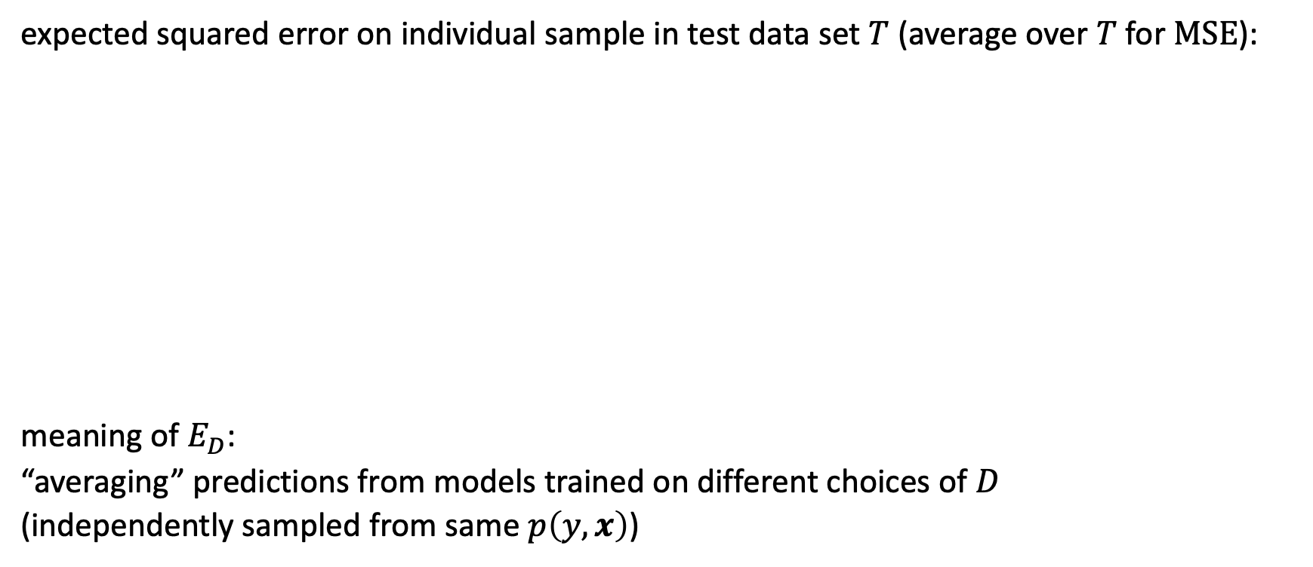
Bias-Variance Decomposition
expected squared error on individual sample in test data set $T$ (average over $T$ for $MSE$):
meaning of $E_{D}$:
“averaging” predictions from models trained on different choices of $D$
(independently sampled from same $p\left(y, x\right)$)
$$E_{D,ε}\left[{\left(y_{i}−\hat{f}\left(x_{i};D\right)\right)}^{2}\right]={\left(E_{D}\left[\hat{f}\left(x_{i};D\right)\right]−f\left(x_{i}\right)\right)}^{2}+E_{D}\left[{\left(E_{D}\left[\hat{f}\left(x_{i};D\right)\right]−\hat{f}\left(x_{i};D\right)\right)}^{2}\right]+σ^{2}$$
bias
variance
irreducible error

Slide 7

Bias-Variance Tradeoff
fundamental concept in classical statistical learning theory
models of higher complexity have lower bias but higher variance (given the same number of training examples)
generalization error follows U-shaped curve: overfitting once model complexity (number of parameters) passes certain threshold
overfitting: variance term dominating test error
→ increasing model complexity increases test error
from wikipedia

Slide 8

Example: Non-Linear Function Approximation
degree of fitted polynomial
from scikit-learn documentation

Slide 9
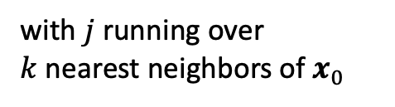

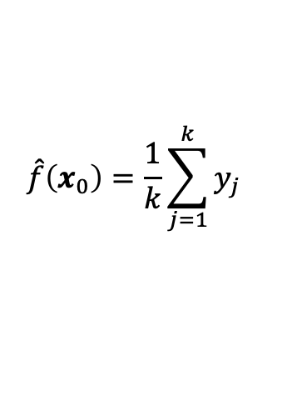
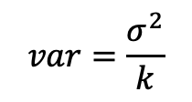
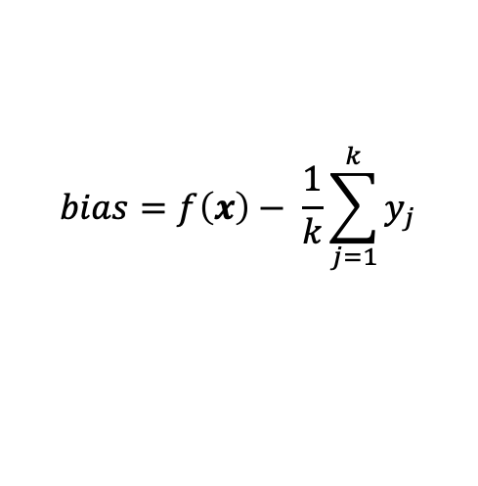
Example: k-Nearest Neighbors
local method, instance-based learning
non-parametric
distance defined by metric on $x$ (e.g., Euclidean)
$$\hat{f}\left(x_{0}\right)=\frac{1}{k}\sum_{j=1}^{k}{y_{j}}$$
with $j$ running over $k$nearest neighbors of $x_{0}$
low k: low bias but high variance
high k: low variance but high bias
$$bias=f\left(x\right)− \frac{1}{k}\sum_{j=1}^{k}{y_{j}}$$
$$var=\frac{σ^{2}}{k}$$

Slide 10
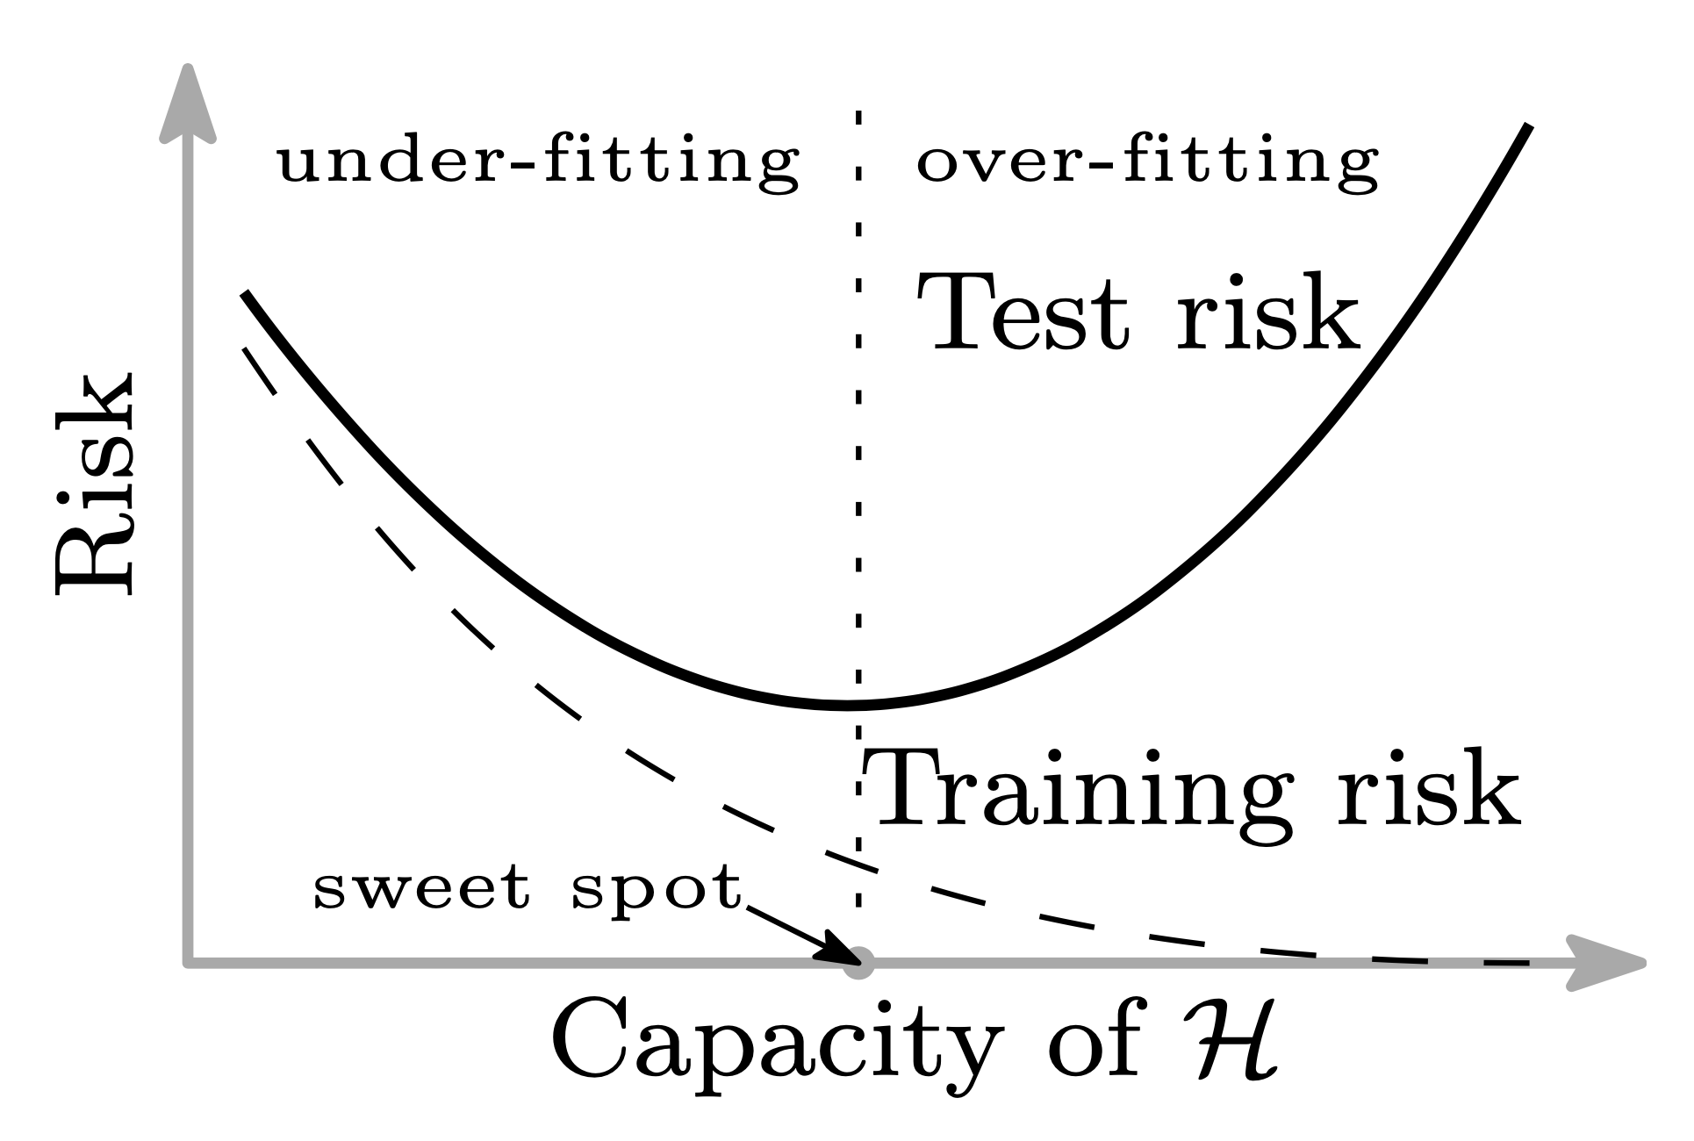
Problem of Finding Complexity Sweet Spot
training/ in-sample error keeps decreasing with more complex model (less bias)
test/out-of-sample error not easily accessible during training
→ e.g., cross-validation, early stopping
from https://arxiv.org/abs/1812.11118

Slide 11
Hyperparameters
model complexity often controlled via hyperparameters (parameters not fitted but set in advance)
examples:
degree of fitted polynomial d
number of considered nearest neighbors k
maximum depth of decision tree
number of trees in random forest
…
hyperparameter tuning

Slide 12
Methods for …
regularization
reducing bias:
kNN: consider less neighbors
decision tree: greater depth
ensemble: boosting
neural network: more hidden nodes
more model features
larger training data set
reducing variance:
kNN: consider more neighbors
decision tree: shallower depth
ensemble: bagging (kind of regularization)
neural network: less hidden nodes
dimensionality reduction, feature selection
larger training data set

Slide 13
Regularization

Slide 14
Supplement to General Recipe of Statistical Learning
adding one more piece to the general recipe of combining models, costs, and optimization methods: regularization
reduce test error, possibly at expense of increased training error
many ways: explicit constraints, adding penalties, priors, parameter sharing, data set augmentation, early stopping, dropout, bagging, …

Slide 15
Idea of Regularization
3 possible scenarios: trained model family …
excluded the true data-generating process (underﬁtting, high bias)
matched the true data-generating process
included the data-generating process, but also many others (overﬁtting, high variance)
goal of regularization: take a model from 3 into 2

Slide 16
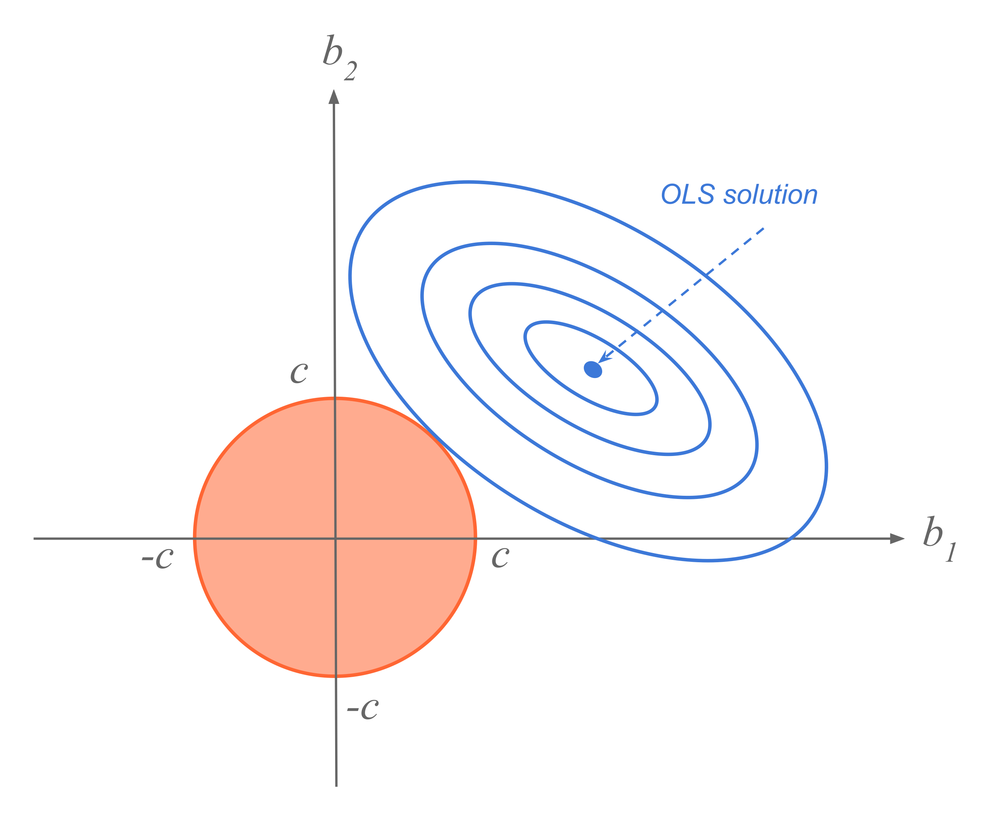
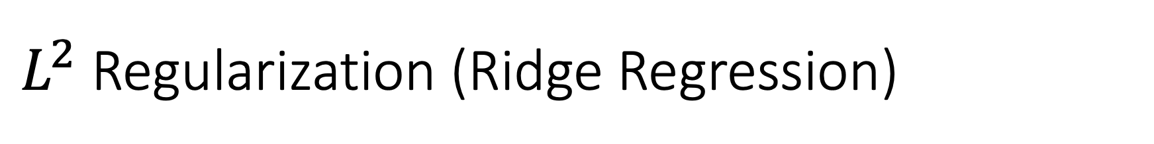
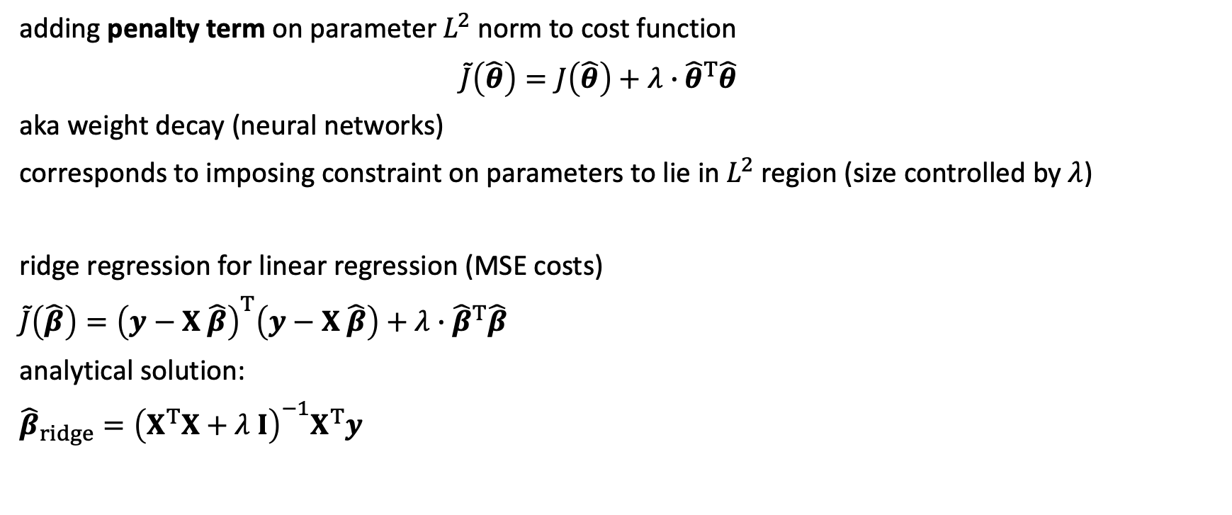
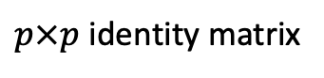
$L^{2}$ Regularization (Ridge Regression)
hyperparameter controlling strength of regularization
adding penalty term on parameter $L^{2}$norm to cost function
$\tilde{J}\left(\hat{θ}\right)=J\left(\hat{θ}\right)+λ∙{\hat{θ}}^{T}\hat{θ}$
aka weight decay (neural networks)
corresponds to imposing constraint on parameters to lie in $L^{2}$ region (size controlled by $λ$)
ridge regression for linear regression (MSE costs)
$\tilde{J}\left(\hat{β}\right)={\left(y−X \hat{β}\right)}^{T}\left(y−X \hat{β}\right)+λ∙{\hat{β}}^{T}\hat{β}$
analytical solution:
${\hat{β}}_{ridge}={\left(X^{T}X+λ I\right)}^{−1}X^{T}y$
$p×p$ identity matrix
source

Slide 17
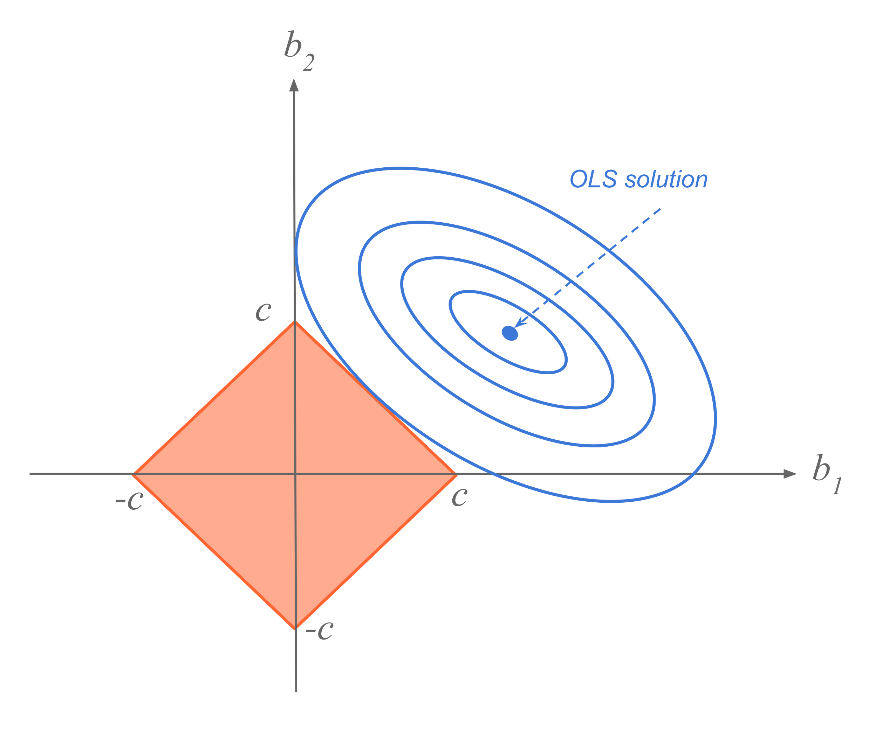
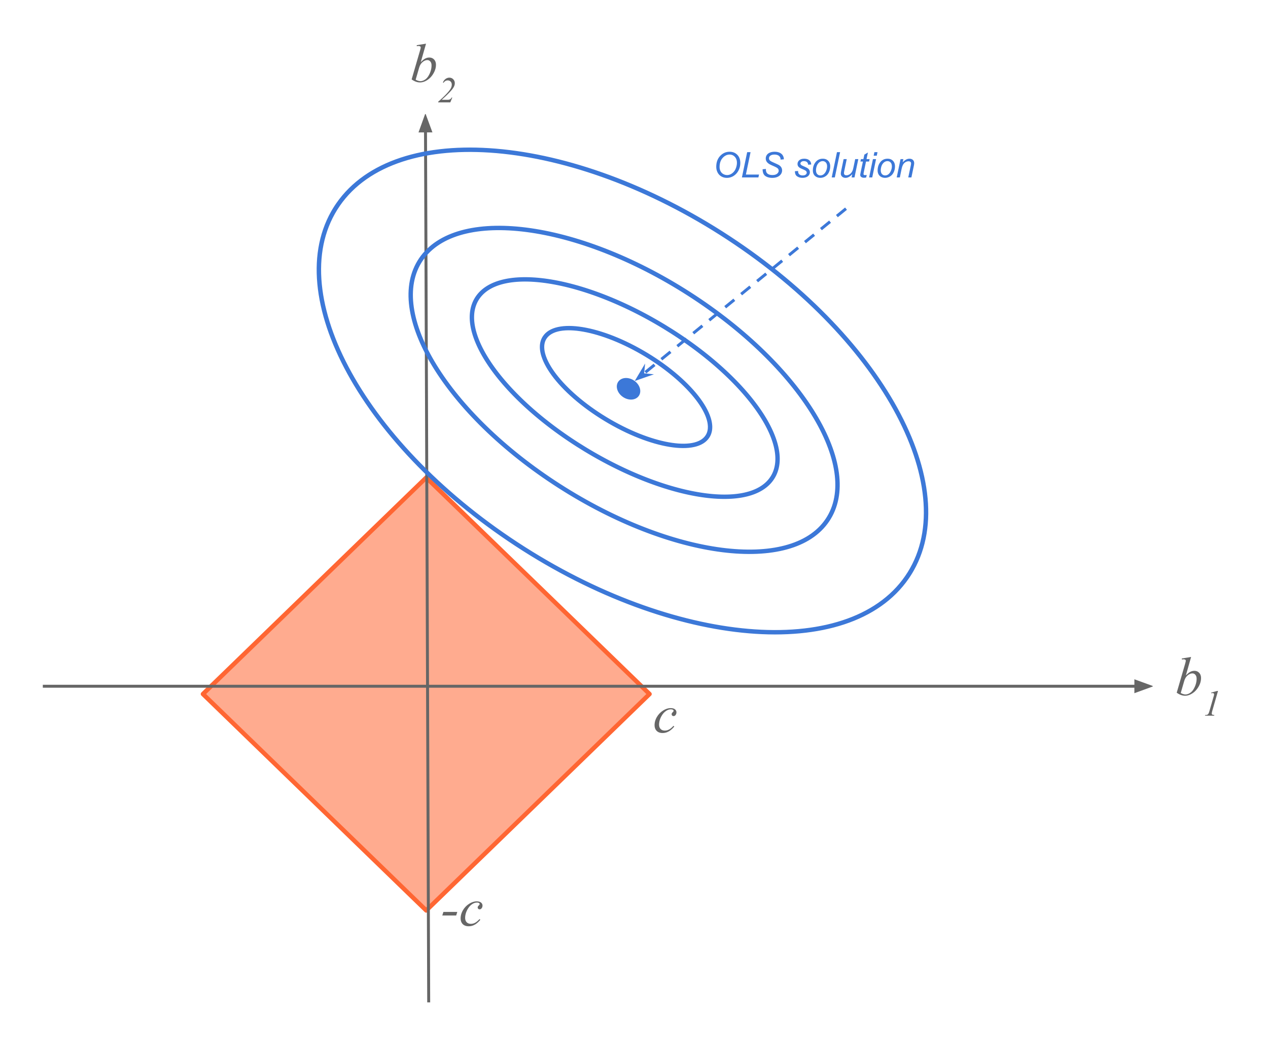
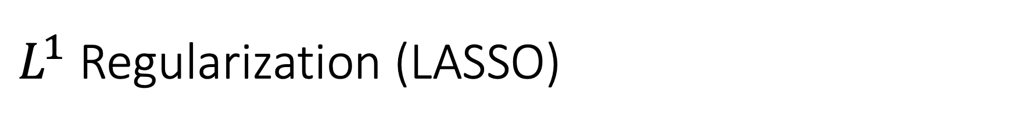
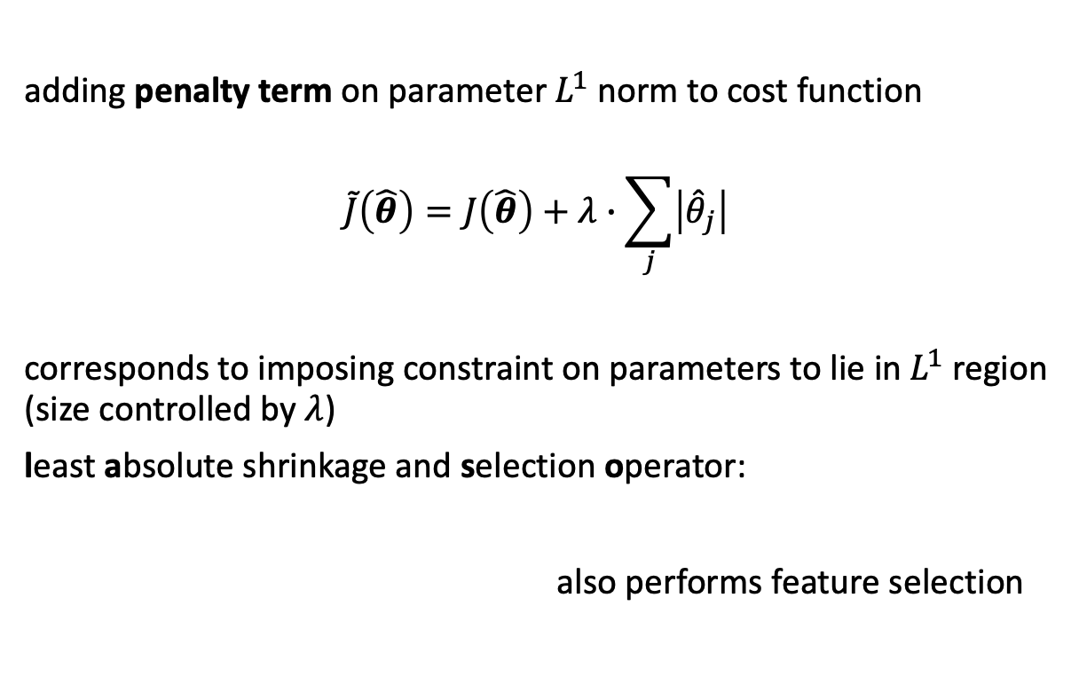
$L^{1}$ Regularization (LASSO)
adding penalty term on parameter $L^{1}$ norm to cost function
$$\tilde{J}\left(\hat{θ}\right)=J\left(\hat{θ}\right)+λ∙\sum_{j}{\left|{\hat{θ}}_{j}\right|}$$
corresponds to imposing constraint on parameters to lie in $L^{1}$ region (size controlled by $λ$)
least absolute shrinkage and selection operator:
also performs feature selection
source

Slide 18
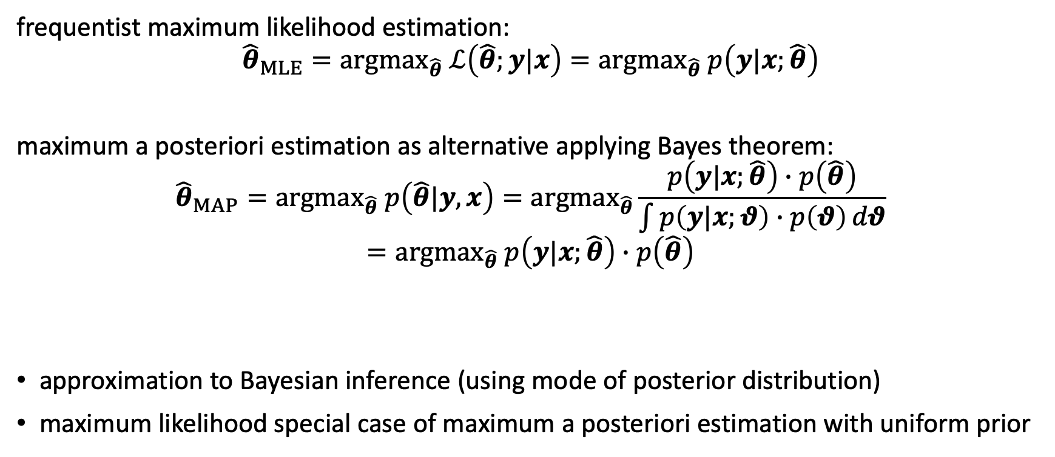
Maximum a Posteriori Estimation
frequentist maximum likelihood estimation:
$${{\hat{θ}}_{MLE}={argmax}_{\hat{θ}} ℒ\left(\hat{θ};y|x\right)=argmax}_{\hat{θ}} p\left(y|x;\hat{θ}\right)$$
maximum a posteriori estimation as alternative applying Bayes theorem:
$${{\hat{θ}}_{MAP}=argmax}_{\hat{θ}} p\left(\hat{θ}|y,x\right)={argmax}_{\hat{θ}}\frac{p\left(y|x;\hat{θ}\right)∙p\left(\hat{θ}\right)}{\int{p\left(y|x;θ\right)∙p\left(θ\right)}dθ}={argmax}_{\hat{θ}} p\left(y|x;\hat{θ}\right)∙p\left(\hat{θ}\right)$$
approximation to Bayesian inference (using mode of posterior distribution)
maximum likelihood special case of maximum a posteriori estimation with uniform prior
posterior distribution
likelihood
prior distribution

Slide 19
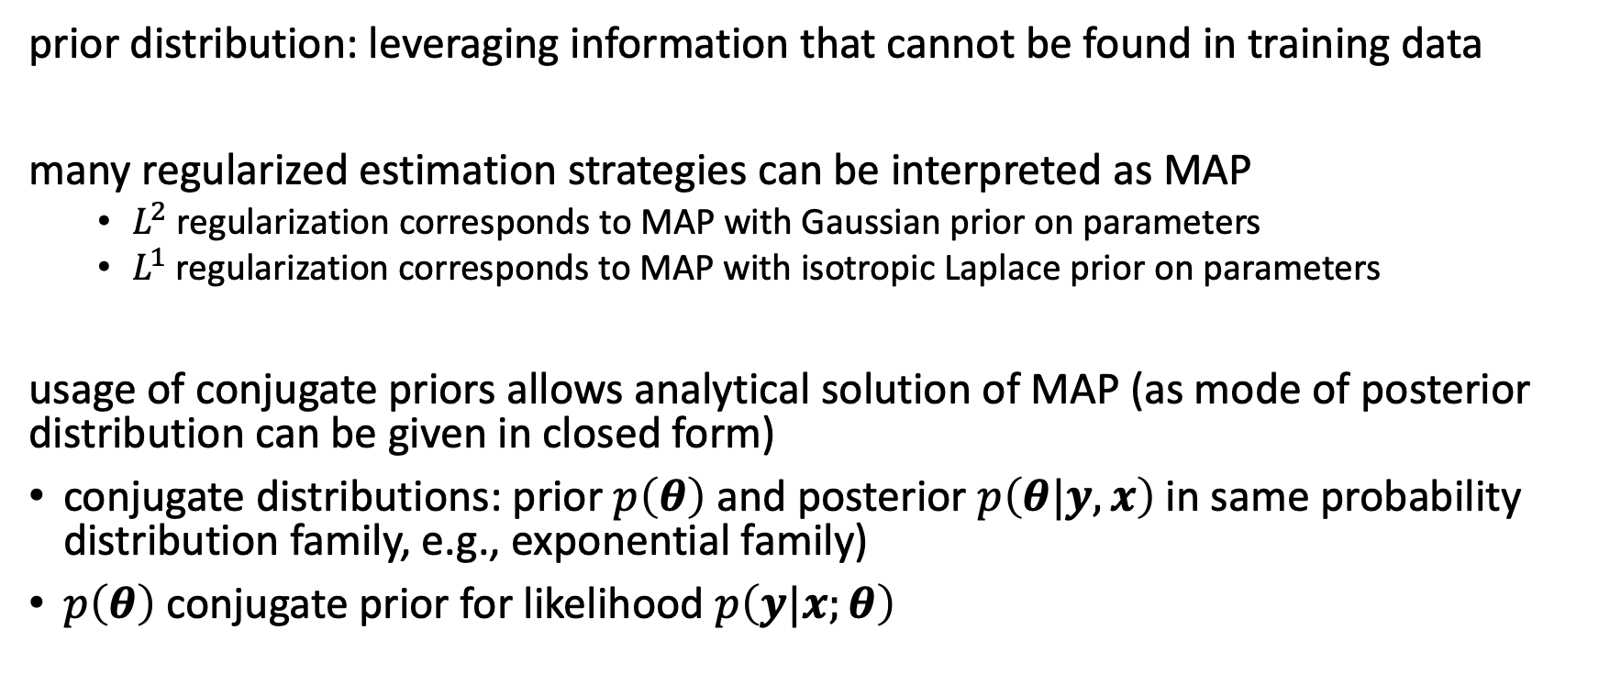
Priors as Regularizers
prior distribution: leveraging information that cannot be found in training data
many regularized estimation strategies can be interpreted as MAP
$L^{2}$ regularization corresponds to MAP with Gaussian prior on parameters
$L^{1}$ regularization corresponds to MAP with isotropic Laplace prior on parameters
usage of conjugate priors allows analytical solution of MAP (as mode of posterior distribution can be given in closed form)
conjugate distributions: prior $p\left(θ\right)$ and posterior $p\left(θ|y,x\right)$in same probability distribution family, e.g., exponential family)
$p\left(θ\right)$ conjugate prior for likelihood $p\left(y|x;θ\right)$

Slide 20
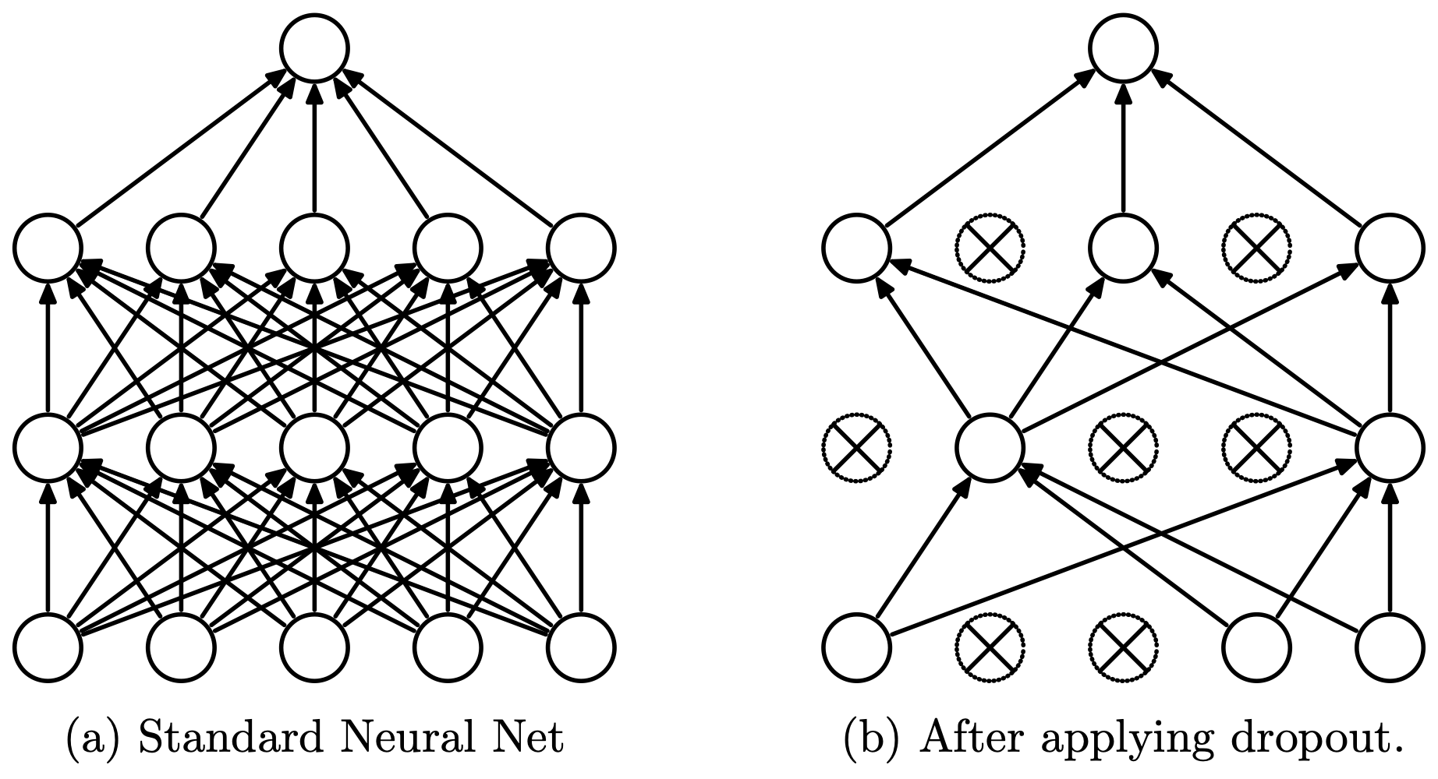
Dropout in Neural Networks
goal: prevent overfitting of large neural networks
idea: randomly drop non-output nodes (along with their connections) during training (not prediction)
implicit ensemble method (kind of sampling from exponentially many differently thinned networks): for each mini-batch, randomly sample independent binary masks for the nodes
inexpensive approximation to bagging (without training many different neural networks) with parameter sharing
source

Slide 21
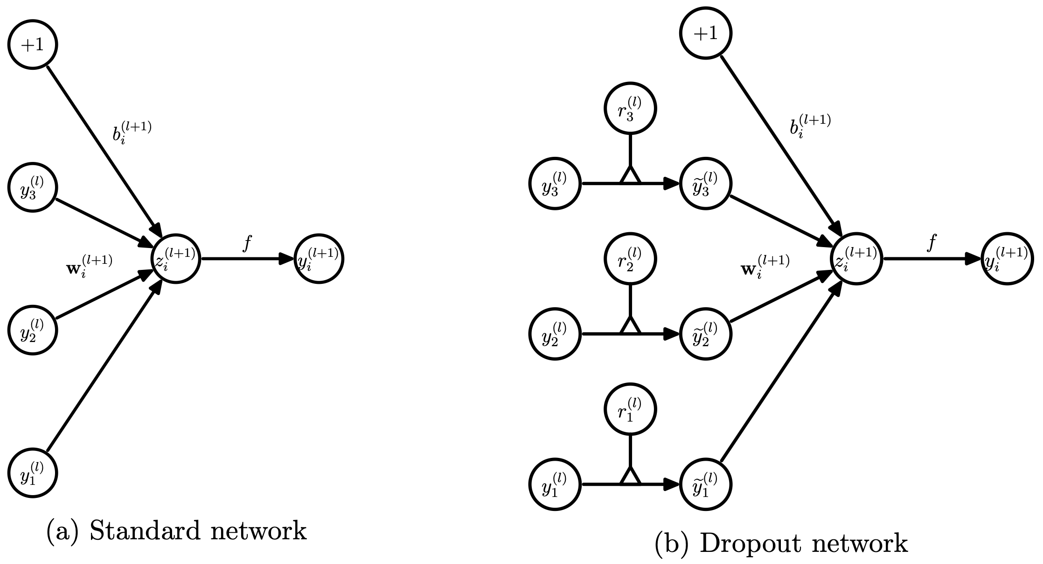
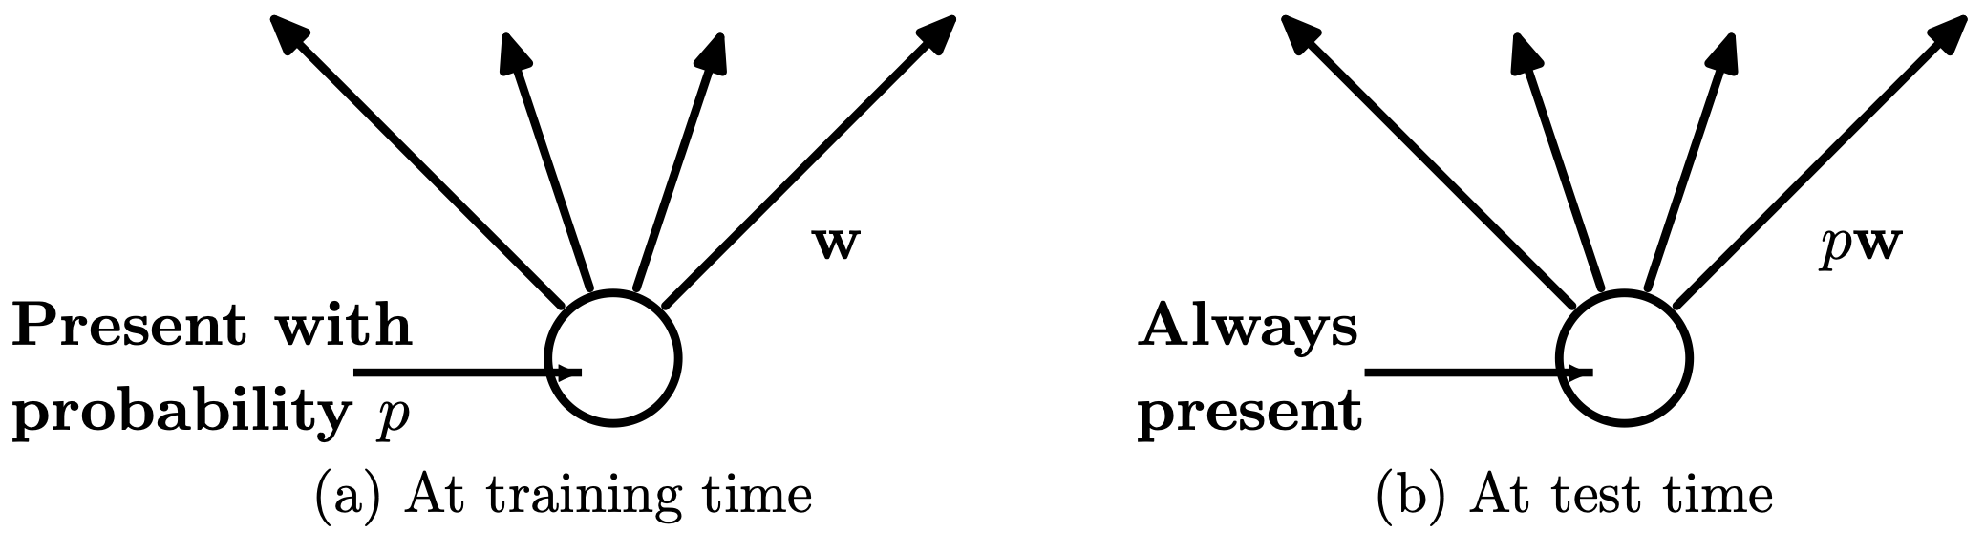
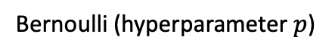
Dropout in Neural Networks
Bernoulli (hyperparameter $p$)
key advantage compared to averaging ensemble of independent models (typical bagging procedure):
better generalization by means of regularizing each hidden node to perform well regardless of which other hidden nodes are in the model (adaptability)
clever noise injection method: destroying extracted features rather than input values
weight scaling inference rule (approximating ensemble predictions)
source

Slide 22
Convolutional Neural Networks (CNN)

Slide 23
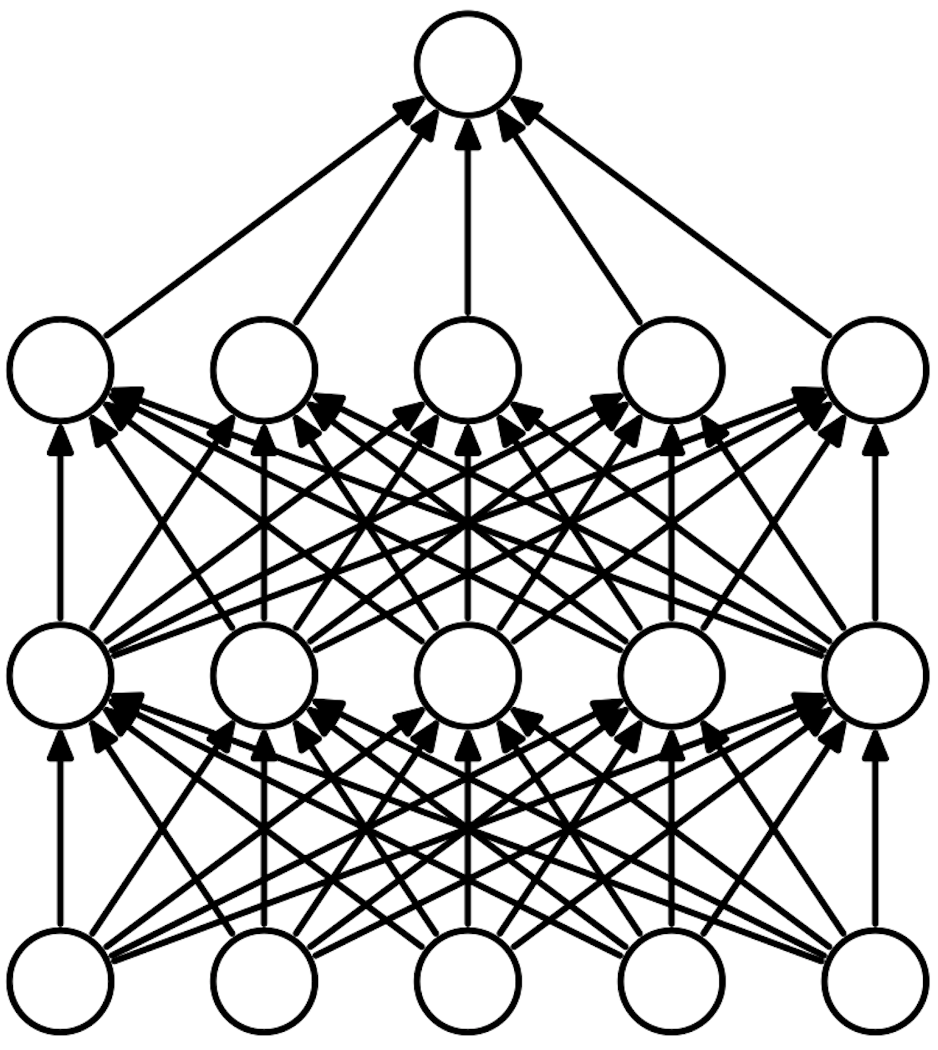
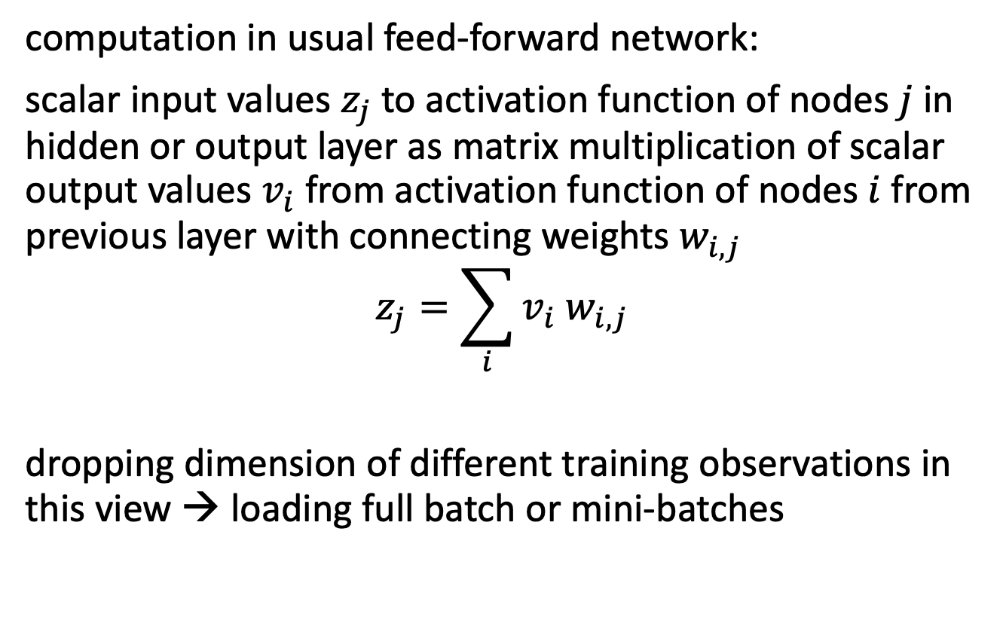
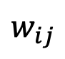
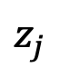
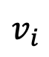
Recap: Feed-Forward Neural Networks
computation in usual feed-forward network:
scalar input values $z_{j}$to activation function of nodes $j$ in hidden or output layer as matrix multiplication of scalar output values $v_{i}$from activation function of nodes $i$ from previous layer with connecting weights $w_{i,j}$
$$z_{j}=\sum_{i}{v_{i} w_{i,j}}$$
dropping dimension of different training observations in this view → loading full batch or mini-batches
$$z_{j}$$
$$w_{ij}$$
$$v_{i}$$

Slide 24

Grid-Like Data
scalar value (like in usual feed-forward network)
data with grid-like topology (spatial structures), e.g.:
time-series data: 1-D grid of data taken at regular time intervals (can also be done with recurrent neural networks or transformers)
image data: 2-D grid of pixels (→ computer vision)
convolutional networks: neural networks using convolution in place of general matrix multiplication in at least one of their layers
→ highly regularized feed-forward networks
source

Slide 25
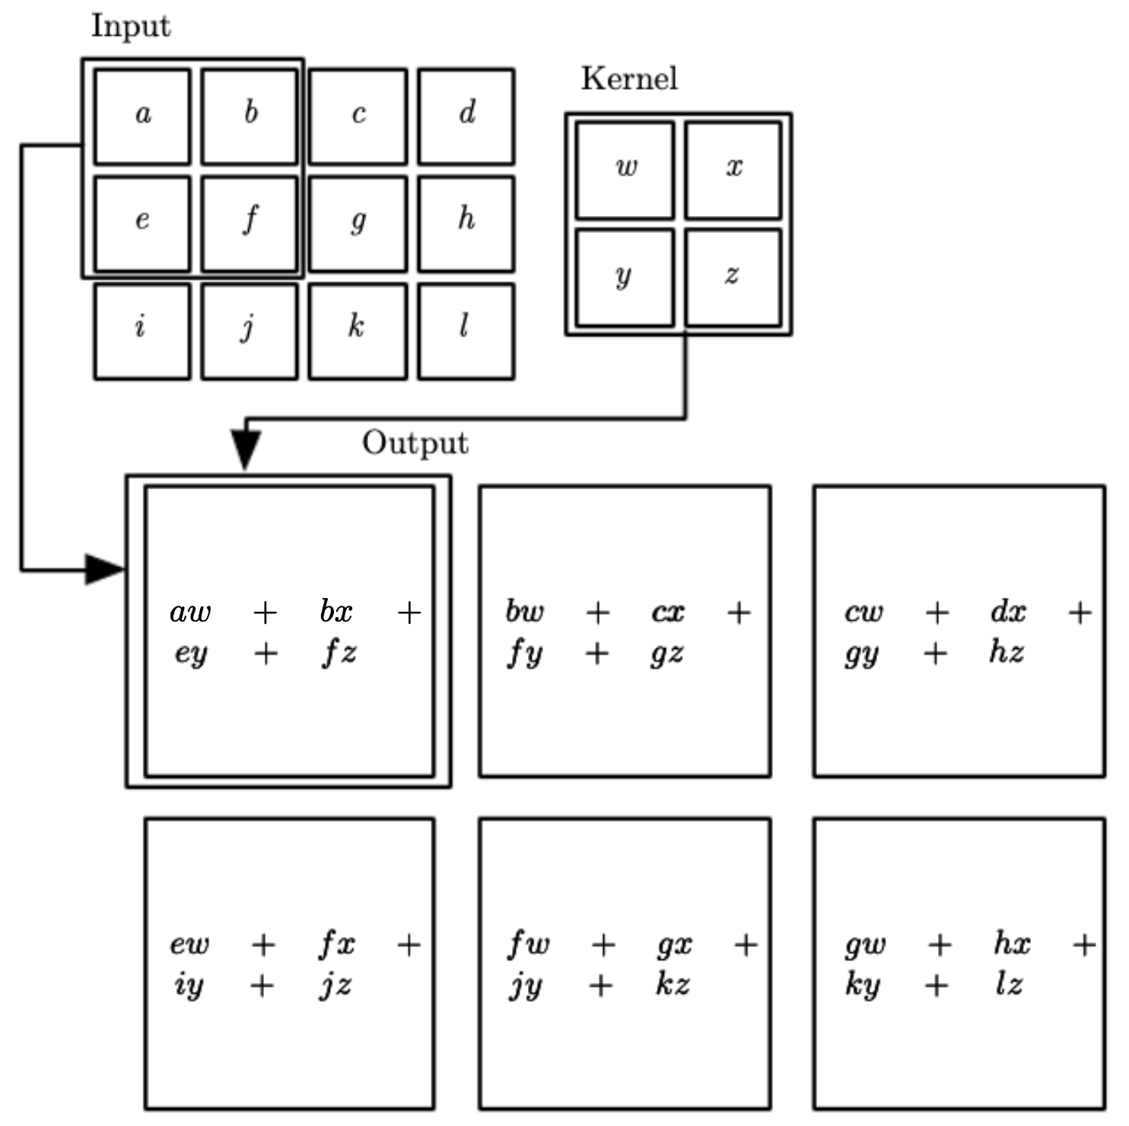
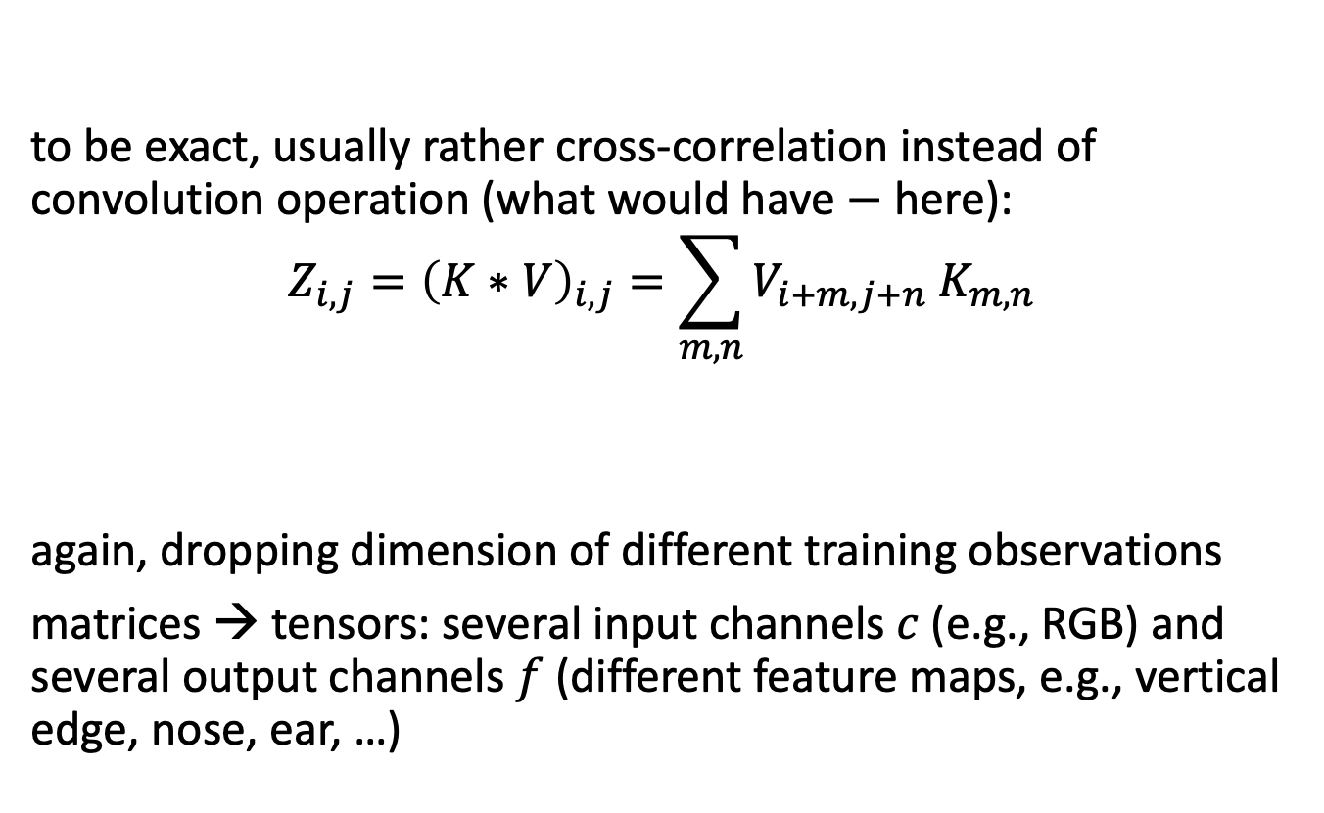
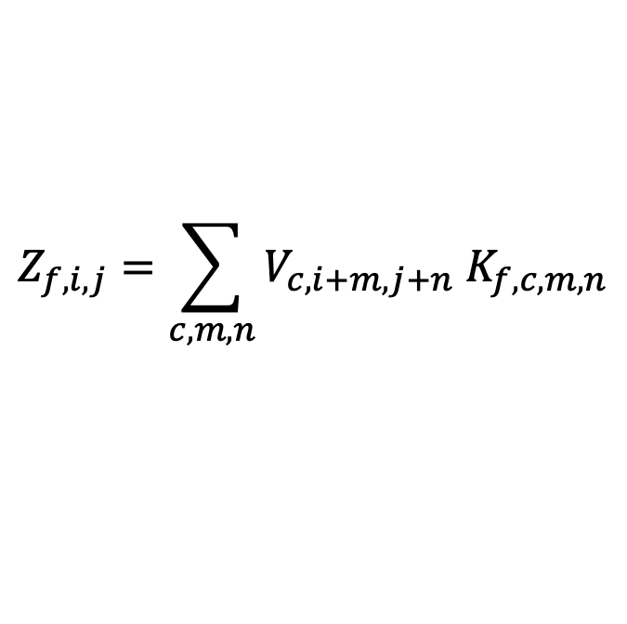
Convolution Operation
learned parameters
to be exact, usually rather cross-correlation instead of convolution operation (what would have $−$ here):
$$Z_{i,j}={\left(K∗V\right)}_{i,j}=\sum_{m,n}{V_{i+m,j+n} K_{m,n}}$$
again, dropping dimension of different training observations
matrices → tensors: several input channels $c$ (e.g., RGB) and several output channels $f$ (different feature maps, e.g., vertical edge, nose, ear, …)
feature map
input (matrix)
kernel (matrix)
$$Z_{f,i,j}=\sum_{c,m,n}{V_{c,i+m,j+n} K_{f,c,m,n}}$$
source

Slide 26


Regularization Effects
convolutional layer:
sparse interactions: much less weights
parameter sharing: use same weights for different connections
equivariance to translation (not to rotation or scale): e.g., same edge detection across entire image
effect of receptive field:
consider only locally restricted number of input values from previous layer
grows for earlier layers (indirect interactions)
→ hierarchical patterns from simple building blocks
fully-connected layer:
source

Slide 27
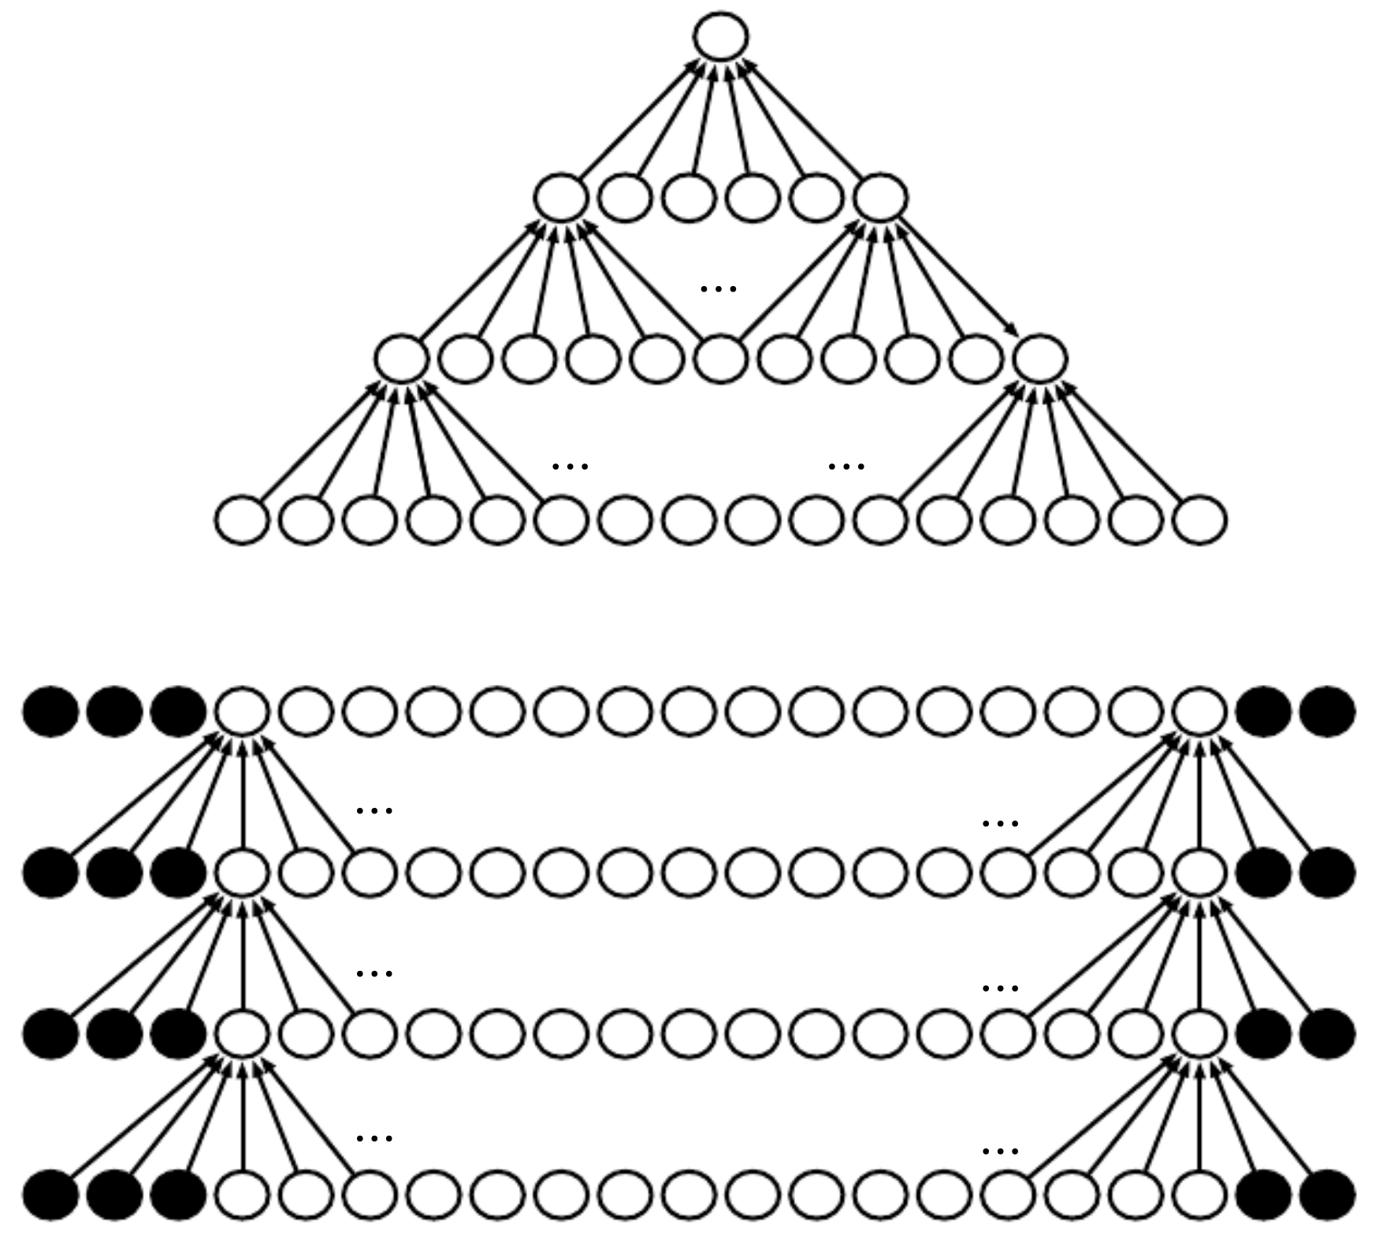
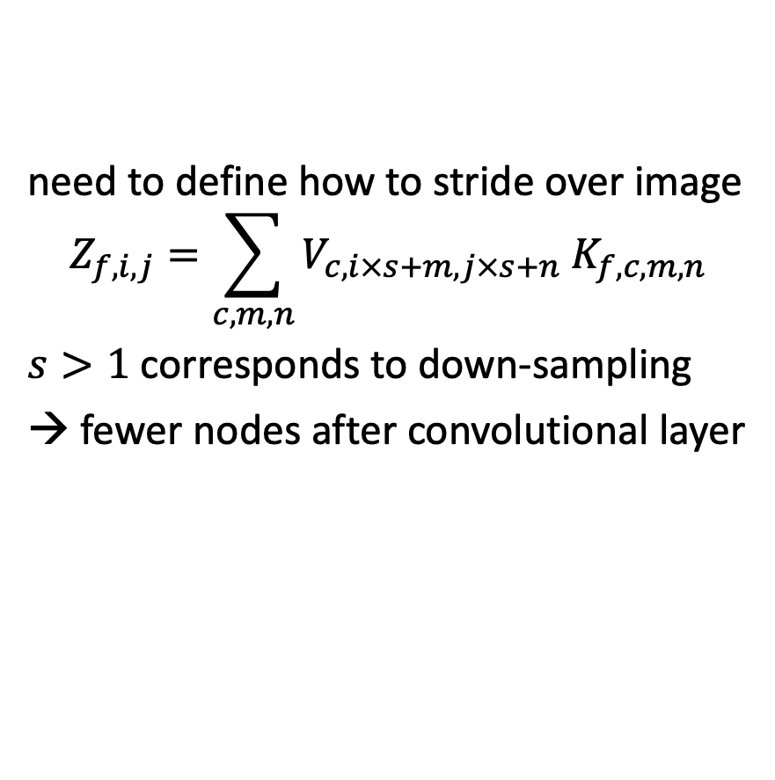
Important Details: Striding and Padding
need to define how to stride over image
$$Z_{f,i,j}=\sum_{c,m,n}{V_{c,i×s+m,j×s+n} K_{f,c,m,n}}$$
$s>1$ corresponds to down-sampling
→ fewer nodes after convolutional layer
zero-padding of input to make it wider:
otherwise shrinking of represenation with each layer (depending on kernel size) → allowing large kernels and slow shrinkage
kernel
input
source

Slide 28

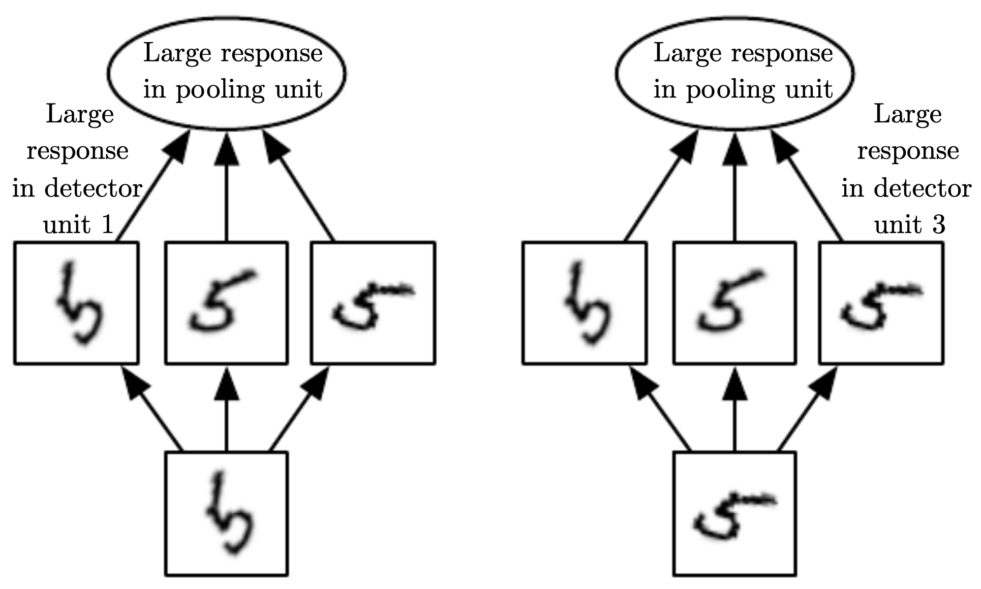
Another Ingredient: Pooling
max pooling:
replacing outputs of neighboring nodes with summary statistic (e.g., maximum or average value of nodes)
→ non-linear down-sampling (regularization)
local translation invariance: no interest in exact postion
pooling over features learned by separate kernels (multi-channel) can learn other transformation invariances
from wikipedia
convolution and pooling can be interpreted as infinitely strong priors
convolution: only local interactions, equivariant to translation
pooling: invariant to small translations
source

Slide 29
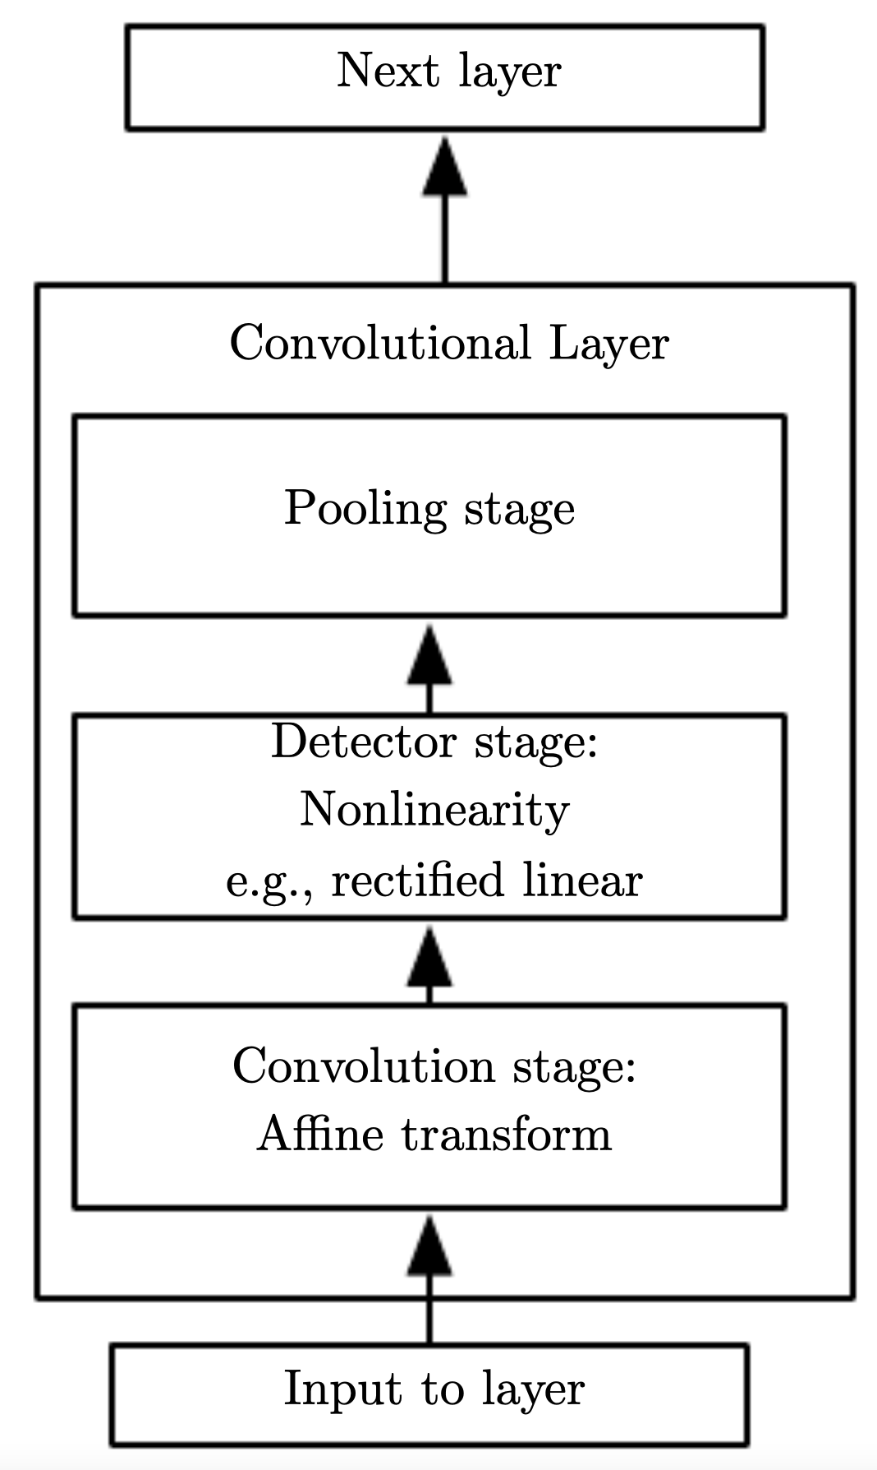
Putting It All Together
many images (training examples), potentially with several channels
down-sampling by convolutions and pooling
several kernels producing several feature maps
flatten dimensions for final classification or regression
source

Slide 30
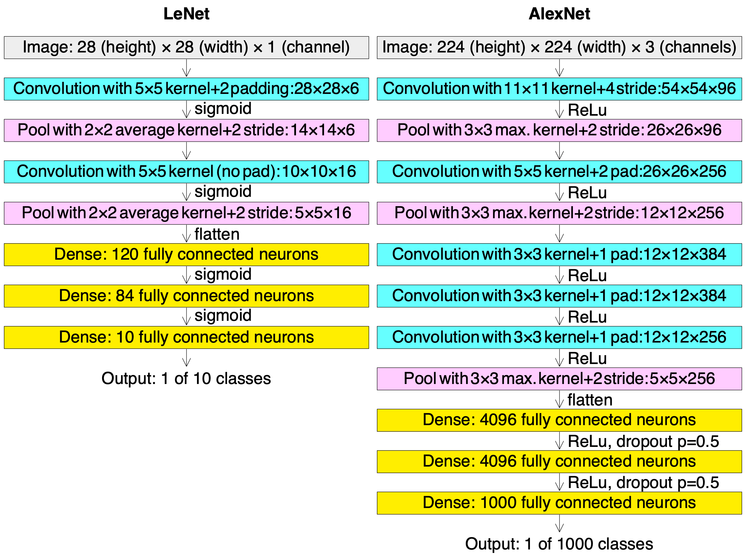
The Pivotal Moment: AlexNet
AlexNet finally started deep learning hype (won ImageNet challenge 2012)
some major improvements:
GPU implementation (enabling more layers → better hierarchical representation)
using ReLU activation functions
using dropout
more data
faster hardware
smarter algorithms
from wikipedia

Slide 31
Inductive Bias

Slide 32
Inductive Bias (aka Learning Bias)
set of assumptions that a learning algorithm uses to predict outputs of given inputs that it has not encountered
(e.g., maximum margin in SVM, translation invariance in CNN)
crucial piece of generalization
data in disguise (replacement for missing information on specific situations in limited training data sets)

Slide 33
No Free Lunch Theorem
All optimization/ML algorithms (both sophisticated and simple ones) perform equally well when their performance is averaged across all possible problems.
(But deep learning is trying to solve many problems with very general-purpose forms of regularization.)
Particularly, model complexity doesn’t reflect if inductive bias is appropriate for problem at hand.
→ choose right ML method for learning task at hand

Slide 34
Double Descent

Slide 35
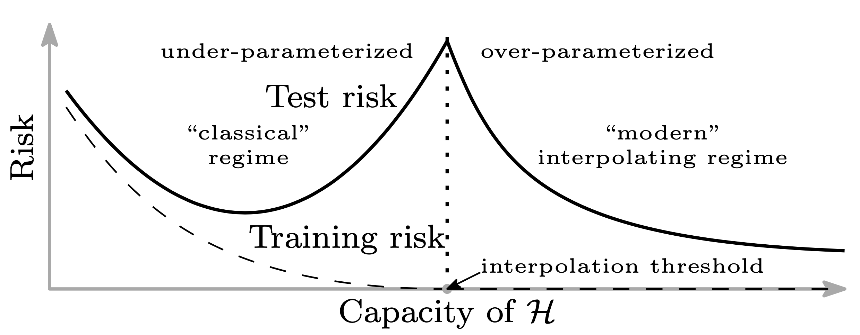
Double Descent in Deep Learning
https://arxiv.org/abs/1812.11118
https://arxiv.org/abs/1912.02292
https://arxiv.org/abs/2201.02177
deep neural networks show additional structure for many parameters:
generalization error first decreases
then peaks (sharp increase in variance) at the interpolation threshold (where training error vanishes)
then decreases monotonically again
from https://arxiv.org/abs/1812.11118
peak can be suppressed by regularization
but potentially also suppression of second descent in case of sub-optimal inductive bias
not only Deep Learning: sufficiently complex, i.e., over-parametrized, ML models

Slide 36
Interpretation of Double Descent
all models right of interpolation threshold fit training data perfectly
find smoothest function that perfectly fits observed data (best inductive bias for task at hand)
a form of Occam’s razor (the simplest explanation compatible with the observations should be preferred)
larger function classes contain more interpolating functions for training data at hand, including simpler/smoother ones (smaller norm)
increasing model complexity can improve generalization (but need more data)
again: over-parametrize and regularize

Slide 37
Memorization First Step Toward Generalization?
many interpolating models (perfectly fitting training data) in over-parameterization regime
empirical evidence that explicit regularization is not necessary for generalization (but helps to choose smooth solution)
→ implicit regularization (tendency of an algorithm to seek out solutions that generalize well on its own)
running Stochastic Gradient Descent to convergence: pick minimum norm solution of different interpolating models → implicitly regularizing

Slide 38

Literature
papers:
CNN: neural networks work (at least for LeCun ☺)
AlexNet: deep learning takes over
dropout
nice historical overview:

Slide 39
Key Challenge for AI: Generalization
common sense of humans or animals enabled by world model (generalized representation of the world, allows to be inattentive to vast amount of irrelevant details)
not yet reached this level of generalization in AI systems
without common sense: need for tons of data and hard-wired engineering of corner cases (example: self-driving cars)

